Slide 1
Hacking Daktronics Shot Clock + RF Capability
Ben Soto, Alex Castellar

Slide 2
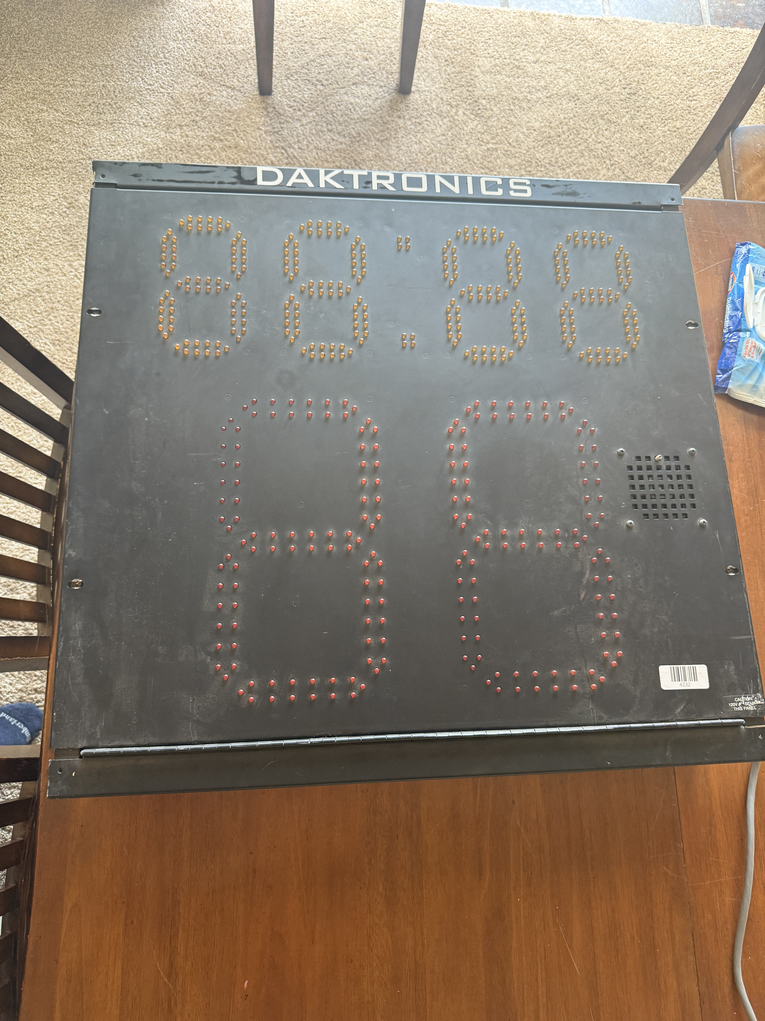
Objectives
Interface with retired Shot Clock using RF transceiver + keypad peripheral + UART
Create controller to enable various features on shot clock
Use RF to send commands remotely
Enable abstraction for simple programming interface

Slide 3
Challenges (many…)
Intial attempt to use SIG_IN -> don’t know communication protocol
Unable to determine LED Driver chip
GPIO can't drive 5V, not all GPIOs are 5V tolerant, + max current
Burnt Nucleo board due to noisy ground on startup (or loose wire)
Desoldering the communication buffer (74HC245) to plug in our own pins
Too much power

Slide 4
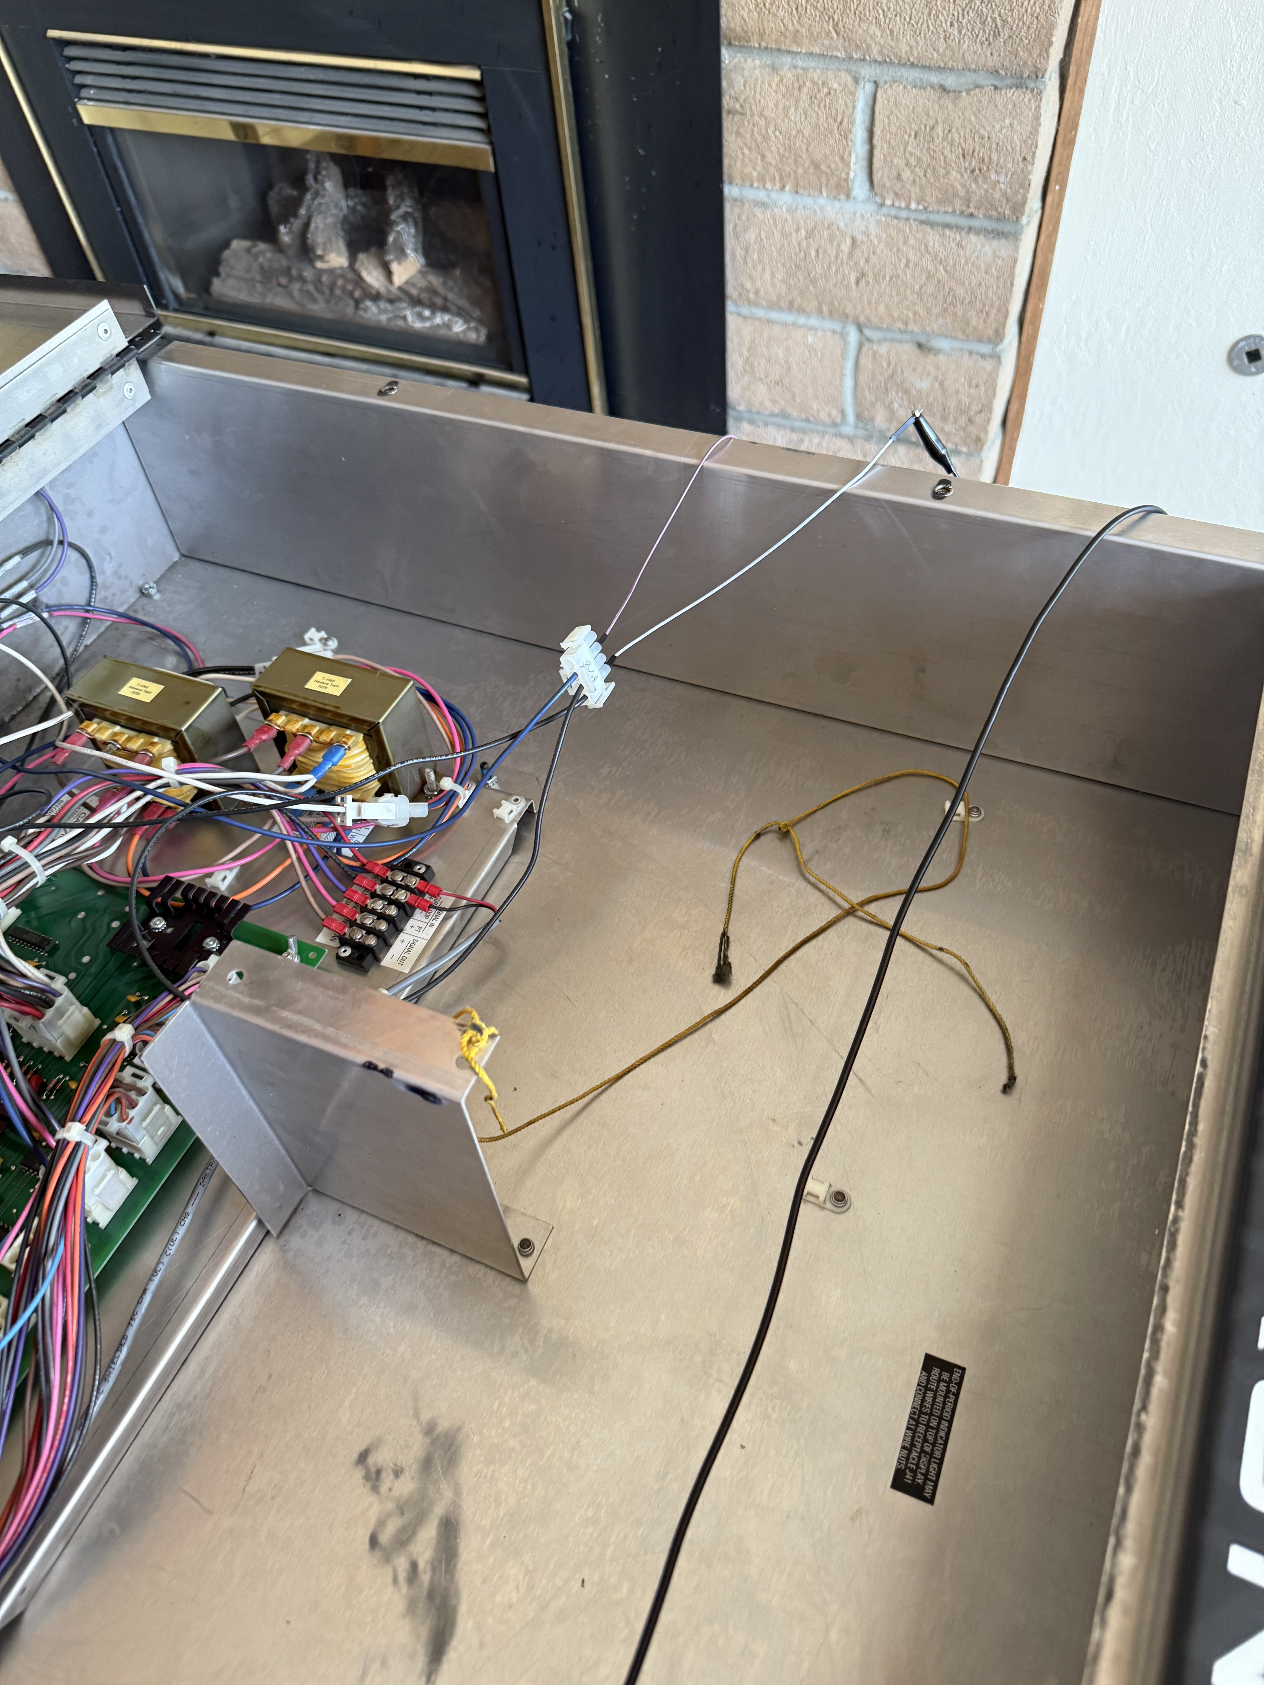
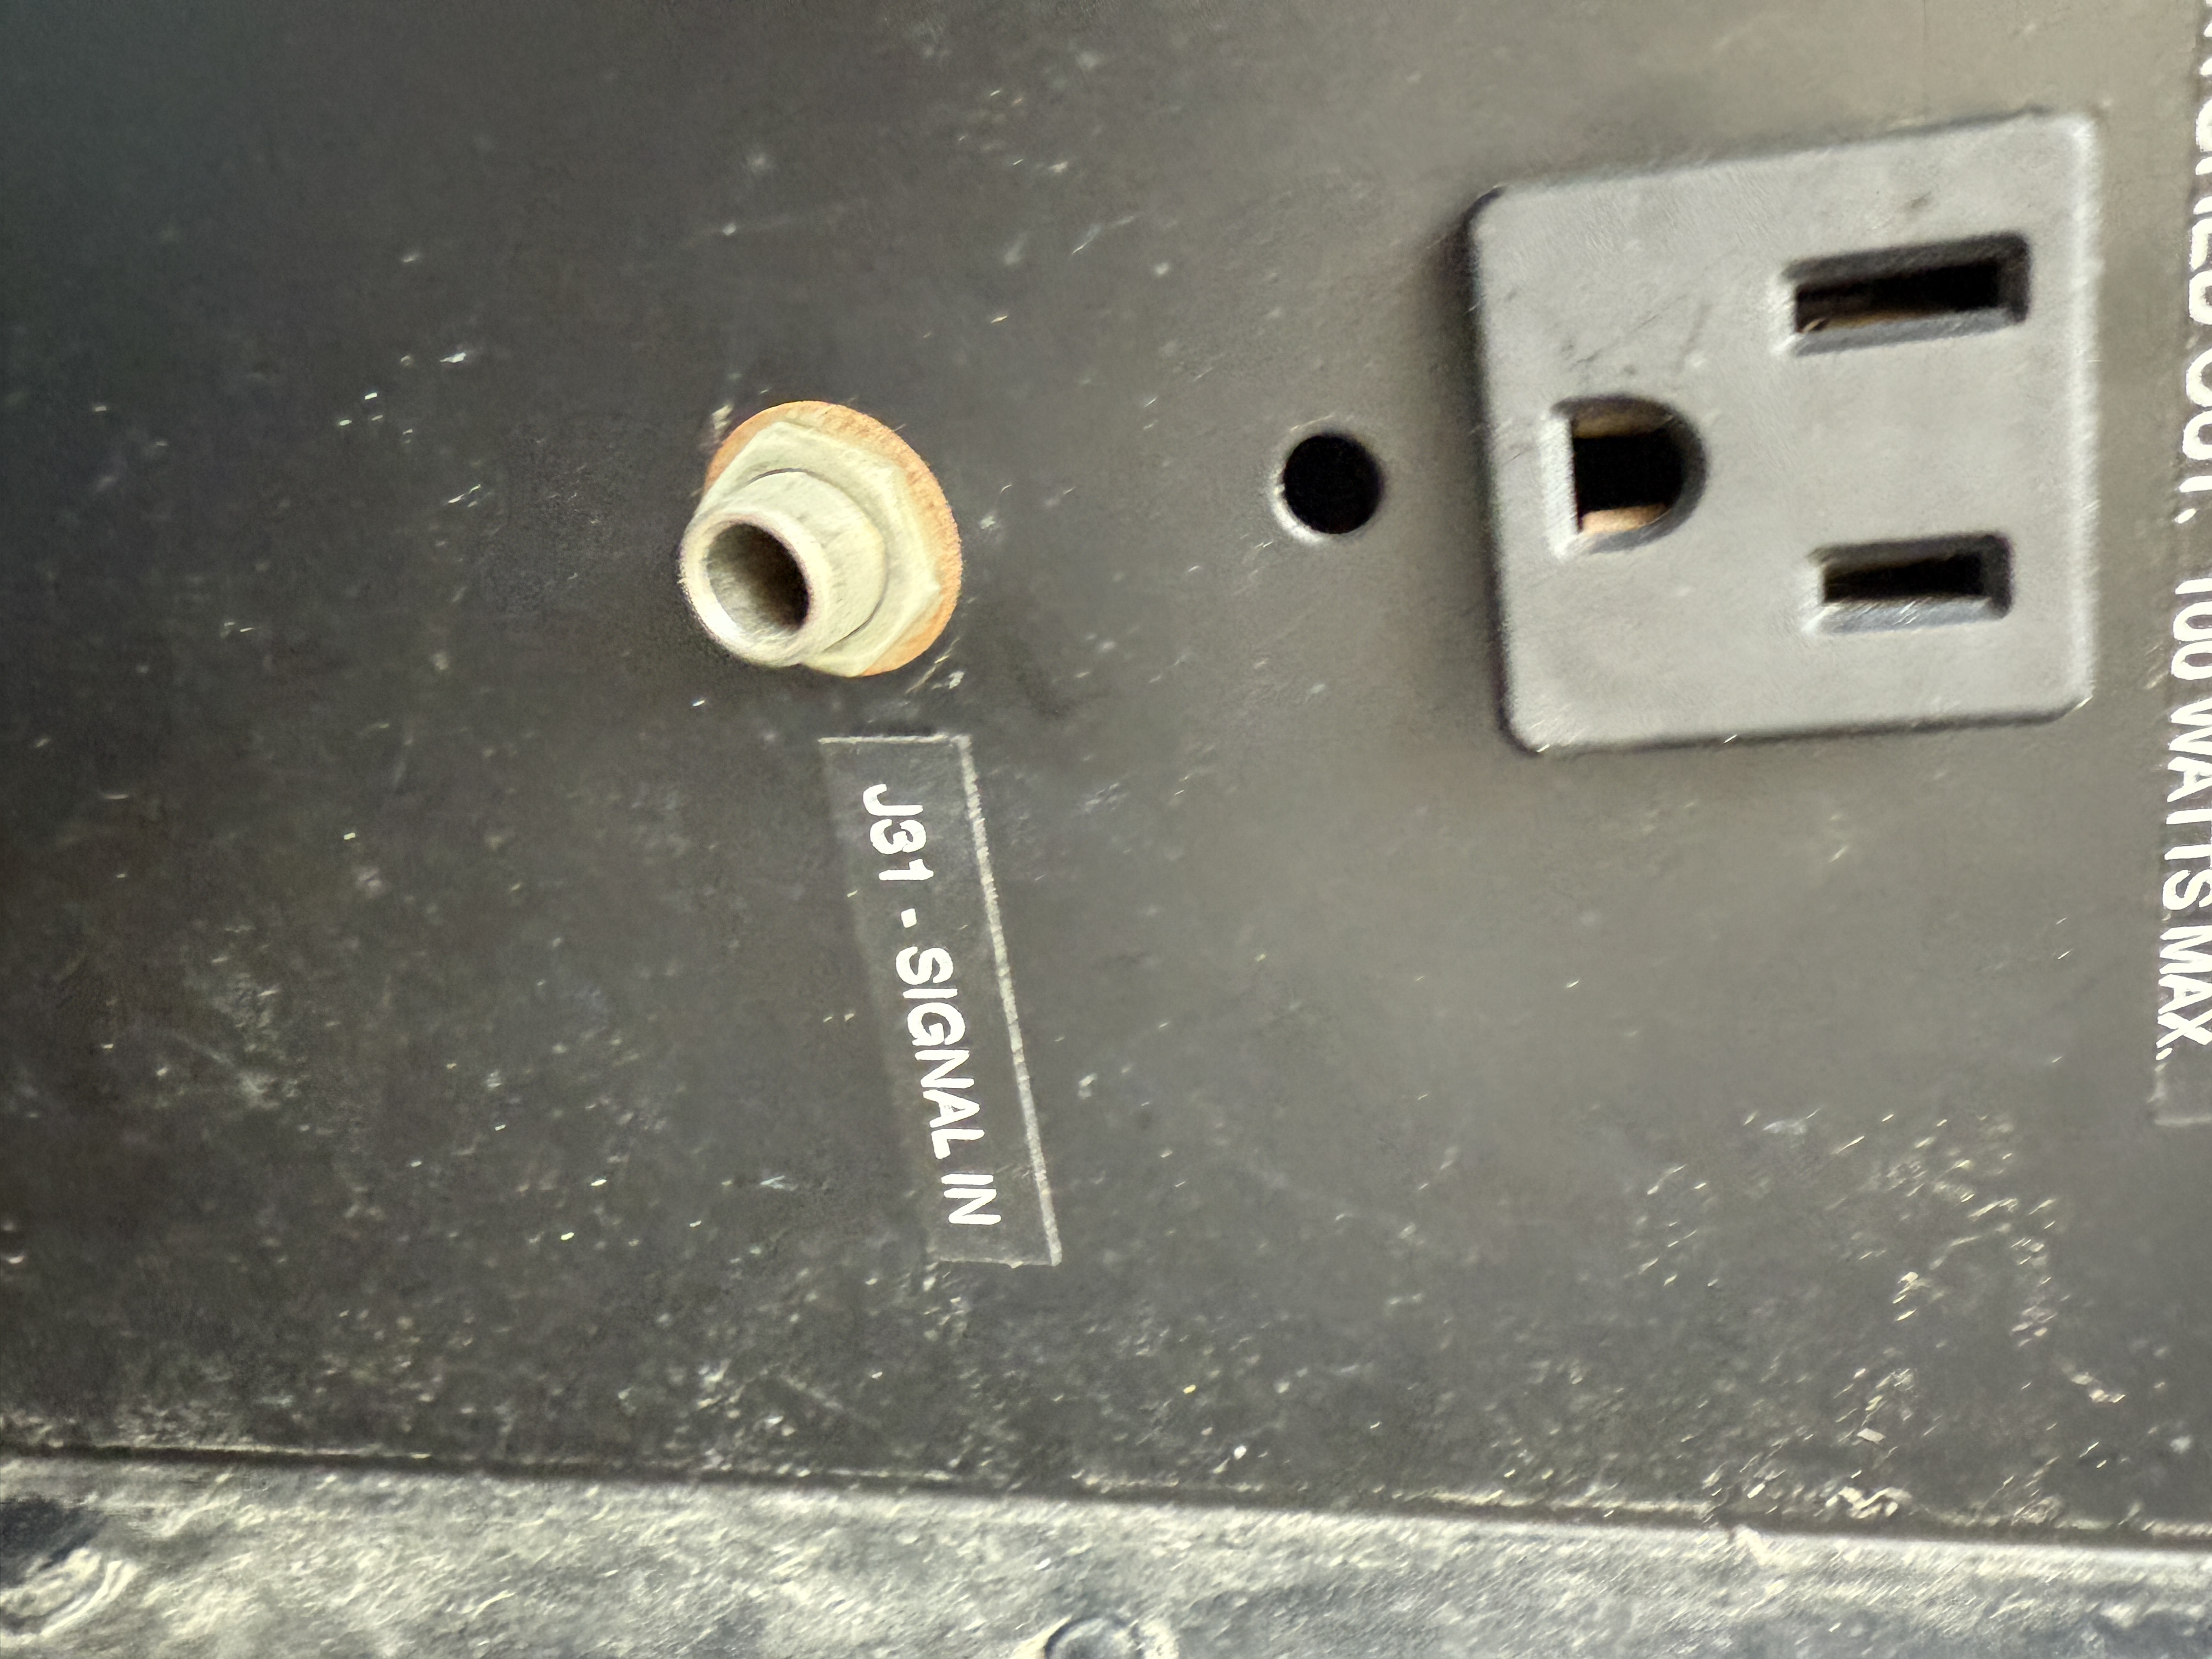
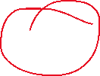

Initial Thoughts
Can we use the Sig-in to create our own control?
Unknown communication protocol
1-wire protocol? Single drive serial wire?
Opto- isolator
Can we use the LED_Driver?
no module #
Can we hack the Shift Regs?
YES!

Slide 5
Hardware Design

Slide 6
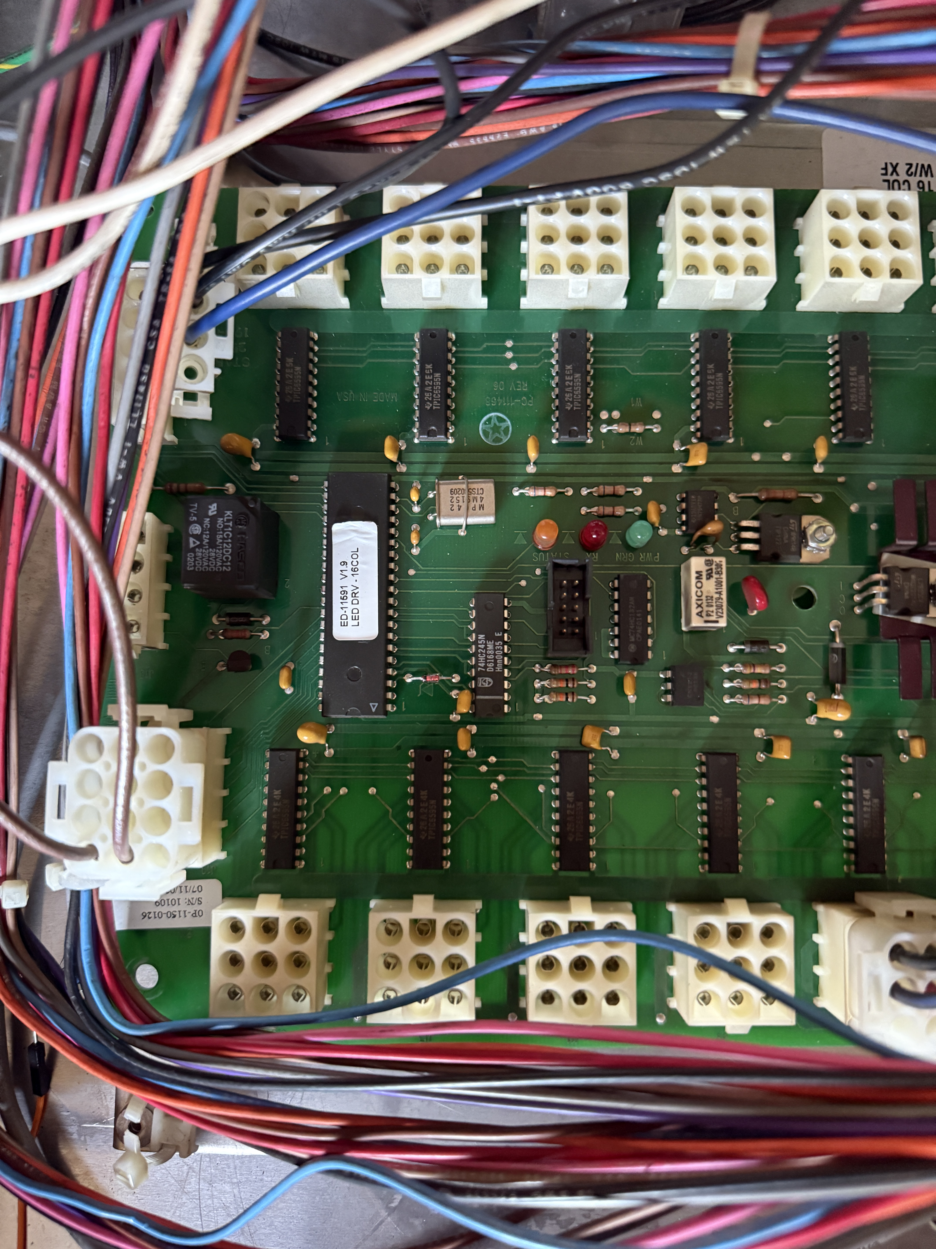
Board
LED Driver
16 shift registers
Bus follower

Slide 7
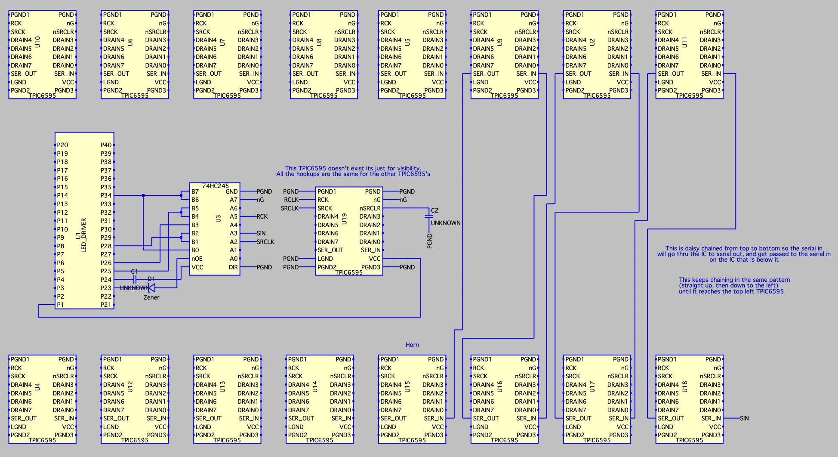
Shock Clock PCB Layout (untouched)
Shift Regs
Drain to SSEGs

Slide 8
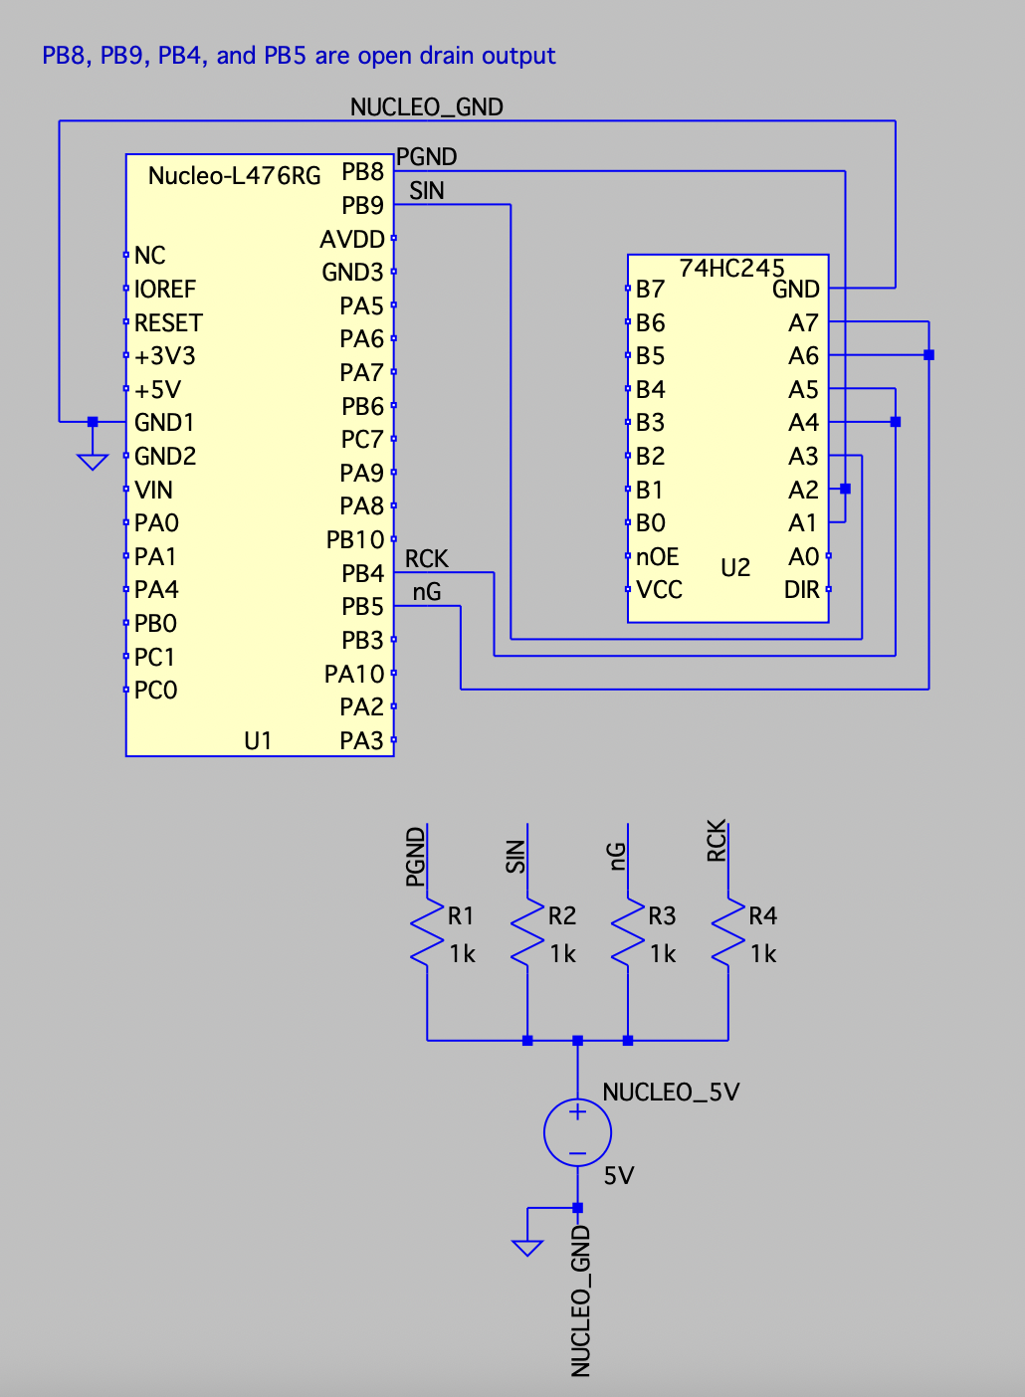
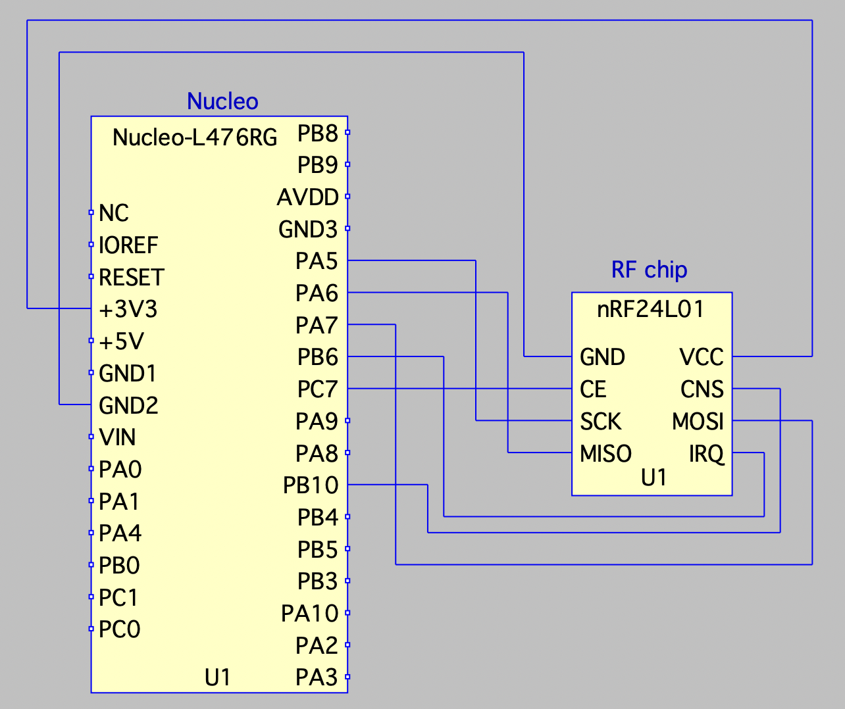
ITERATION 1: Nucleo Interface with 74HC245 and nRF24L01
Control system to directly interface with shift regs
RF Compatibility

Slide 9
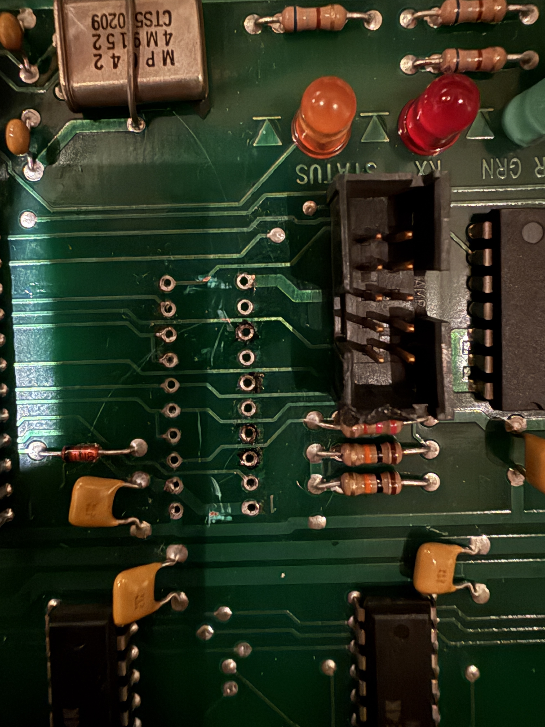
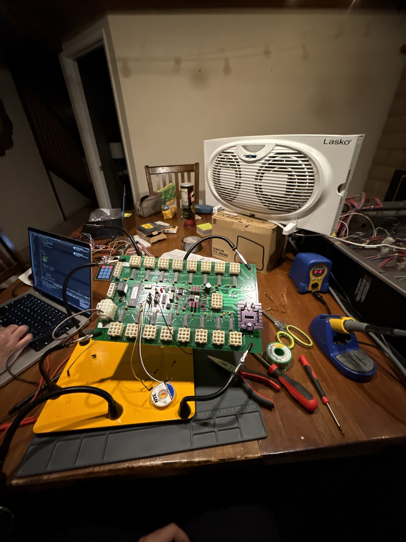
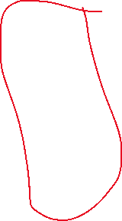

Steal control

Slide 10
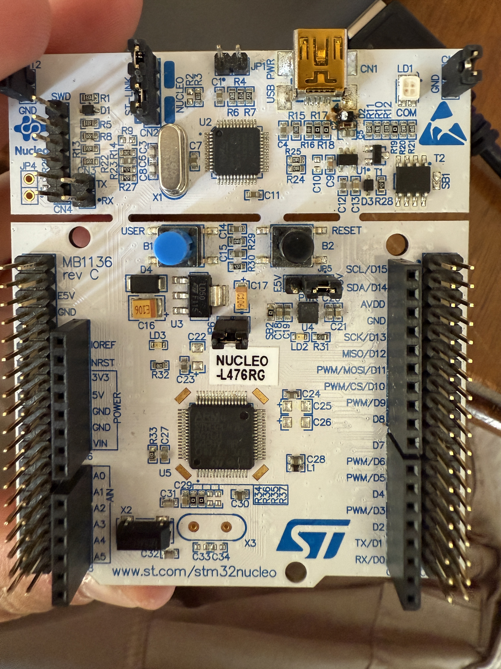
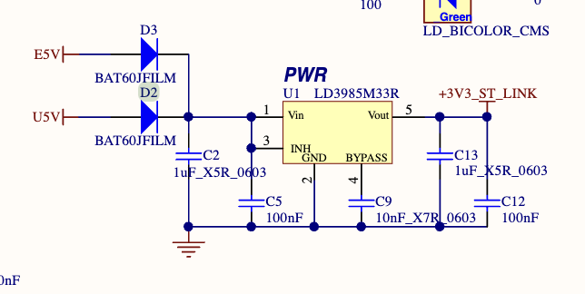

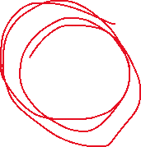
Iteration 1: Design Failure
Cause:
Likely only the shotclock power could break the reg
Likely a ground loop
Or connection shorted to shotclock power
List of Fried Components:
USBC to female USBA adapter
RF Transciever Connected through GPIO to the STM
D2 on Nucelo board + PWR Regulator (now shorted to gnd)
Cannot supply power to the STM
Burnt D2 diode which took down the

Slide 11
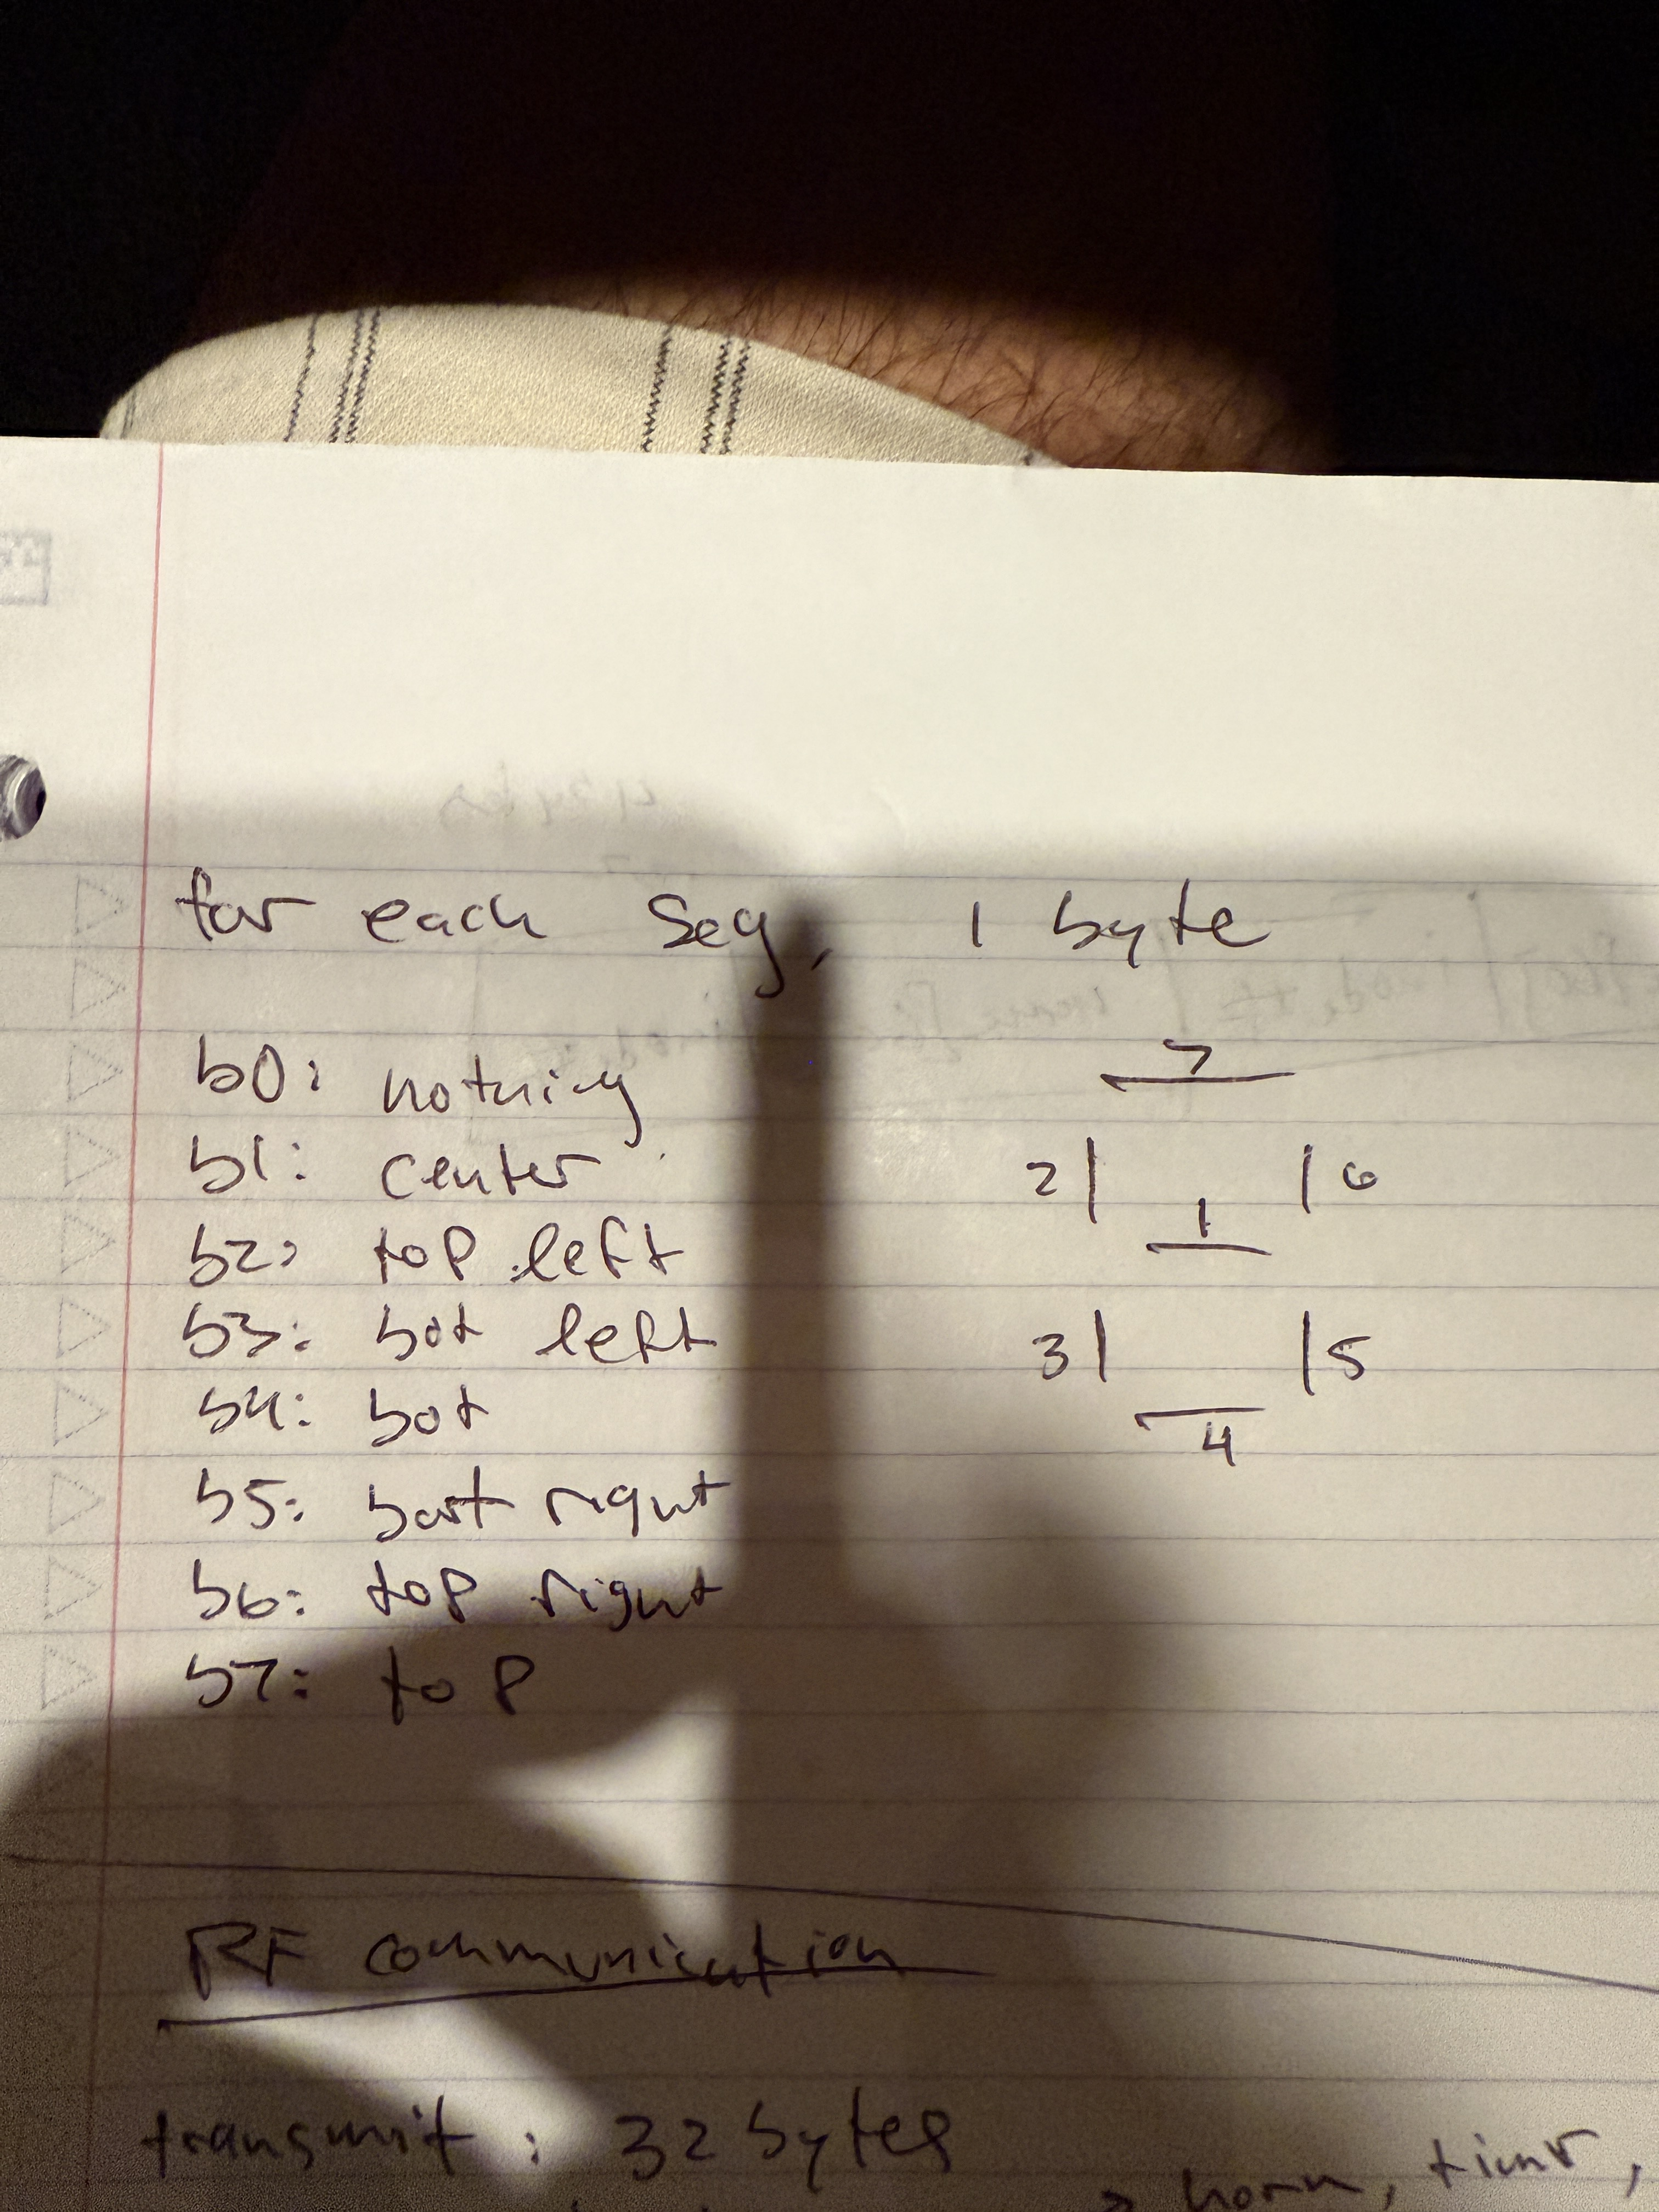
Iteration 1: Lessons Learned
Need to be careful of different grounds and power supplies
Need to put precautions if shorted to VCC
Ground loops are a significant risk we need to manage
Put resistors
We were able to get this working for
long enough to deduce the encoding
of the SSEGs
(shown below)

Slide 12
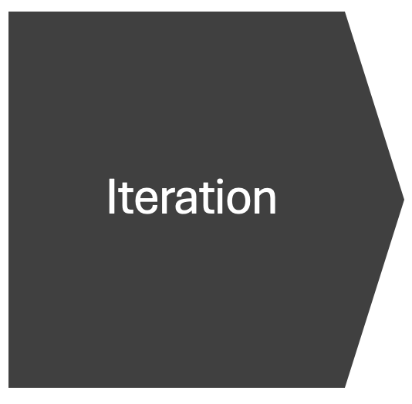
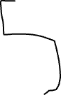

Iteration 3
Flipped jumper to source nucleofrom E5V
Connected shotclock 5V to E5V on nucelo
Disconnected micro-usb before turning on the shotclock
Iteration 2
2
Idea: Use same control system but use
Shotclock 5V for power supply

Slide 13
Issues with Iteration 2
Shotclock 5V could not supply enough current for the Nucleo
Difficult to debug and test as we had to keep laptop disconnected

Slide 14
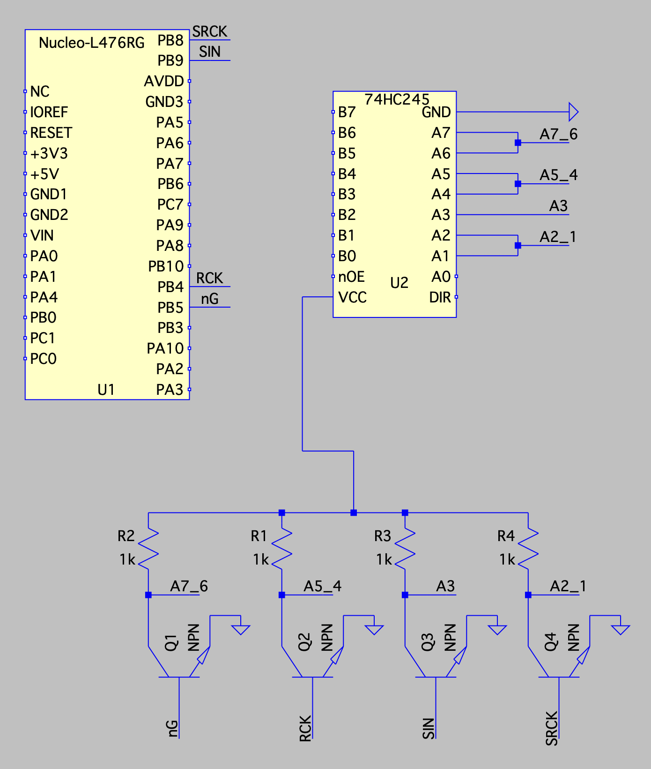
Iteration 3
Idea: separate the two power systems by only using the
STM to control the gates on the NPNs
- Don’t burn the STM by keeping the two separate

Slide 15
Issues with Iteration 3
The control (gate) relies on the potential difference between the gate and the source.
We do not have control over the potential difference since the shot clock and STM utilize different ground
If we send in data to the SIN, nG, RCK, SRCK, we cannot determine the potential difference between gate and source
And if we connect the grounds the power systems are not actually separated

Slide 16
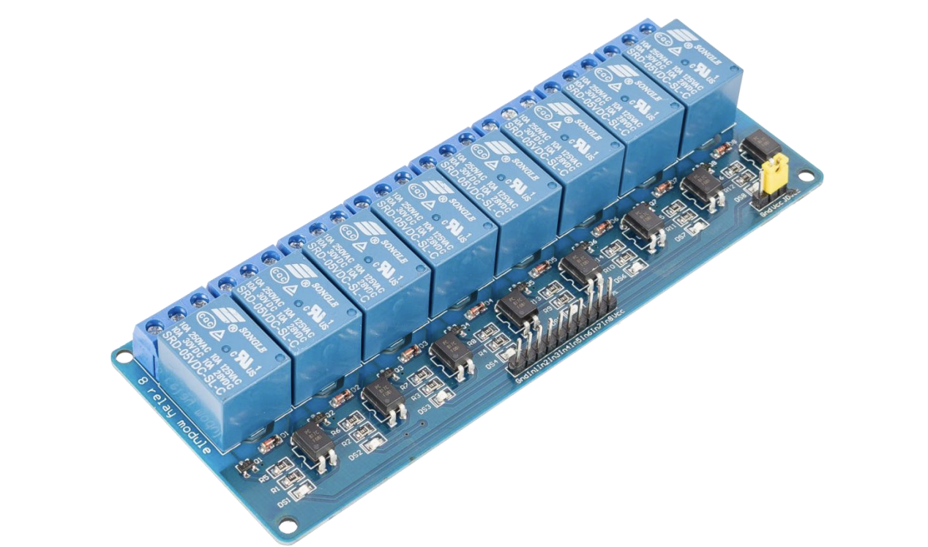
Iteration 4
Idea: separate the two power systems by using a Relay
- Don’t burn the STM by keeping the two separate

Slide 17
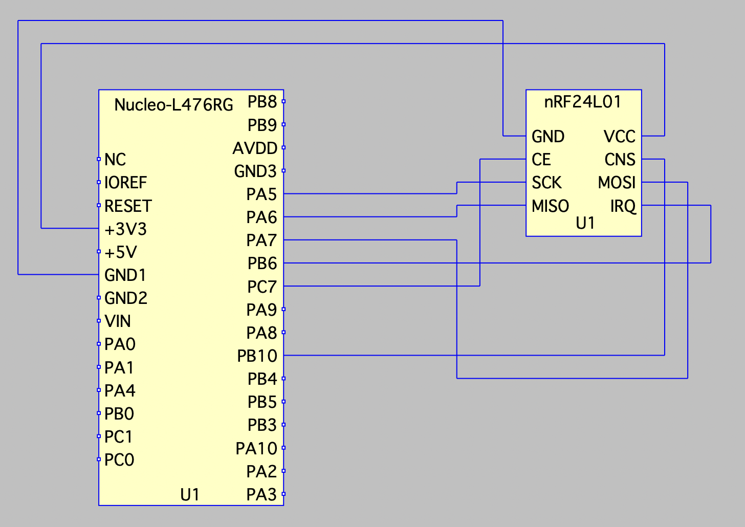
Radio
Idea: Radio via SPI with IRQs
Using module's layer 1 and datalink capabilities Got working but one transceiver got fried, so could not integrate

Slide 18
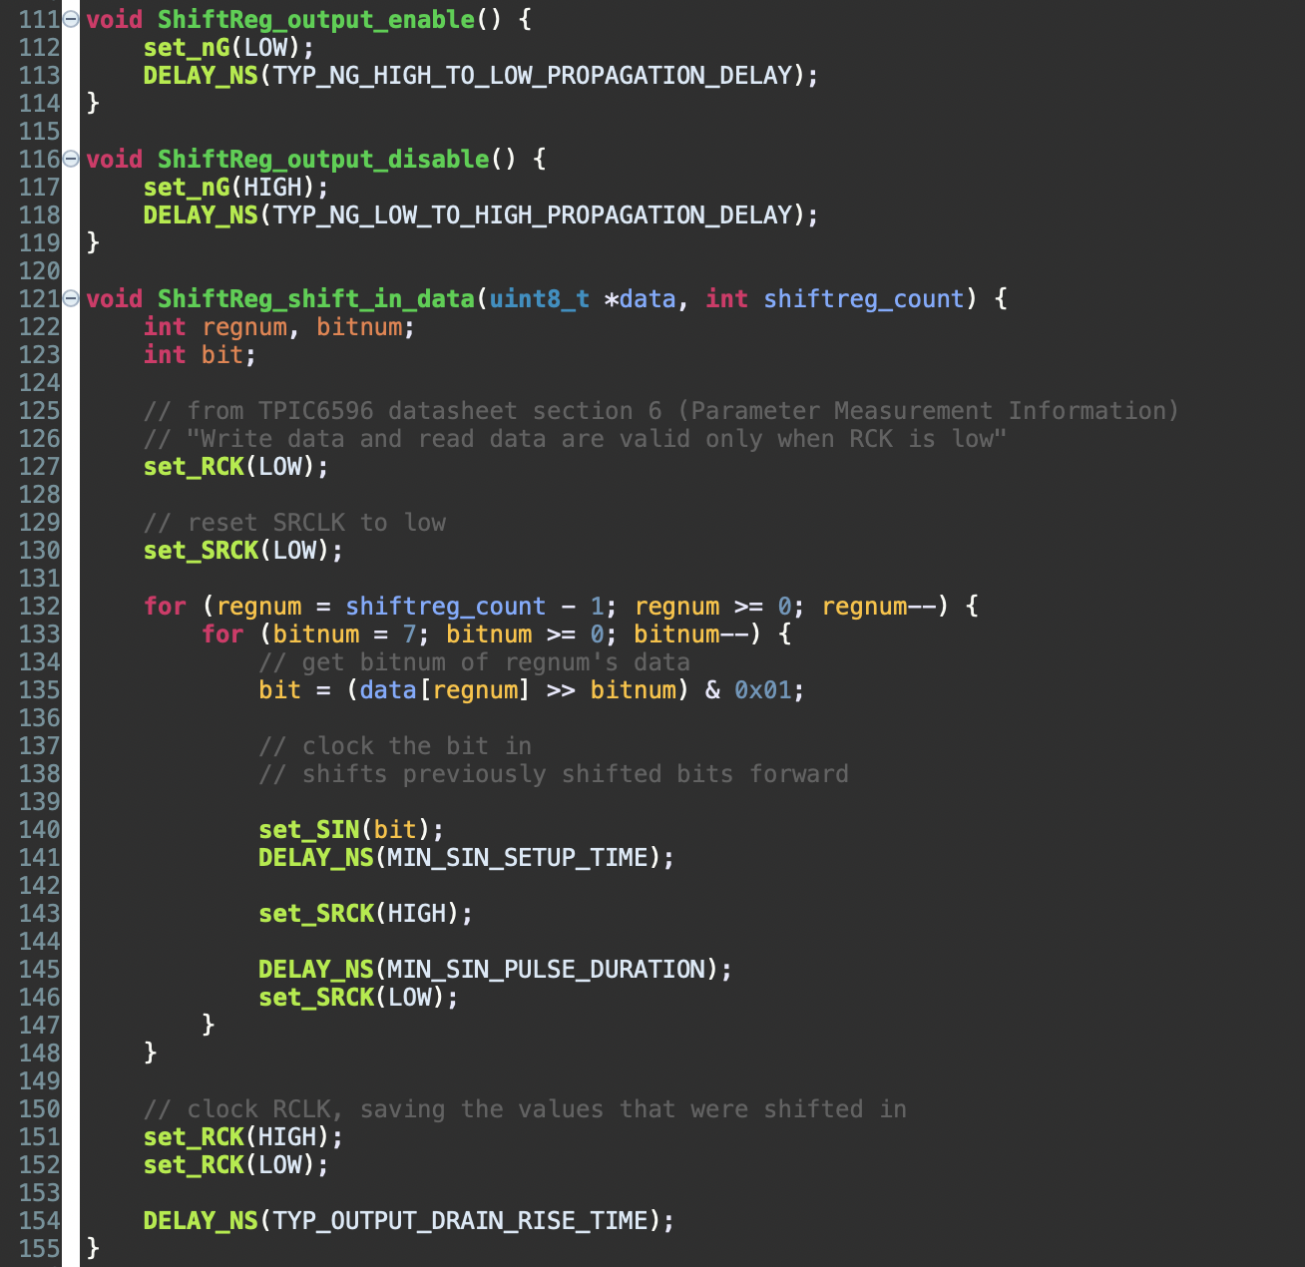
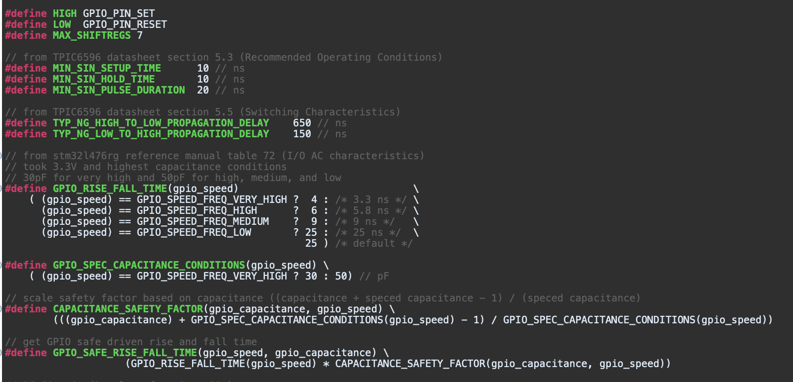
Software Design: Shift Reg
Shift in following datasheets
Open Drain GPIOs at Very High speed
Put bits in on opposite direction

Slide 19
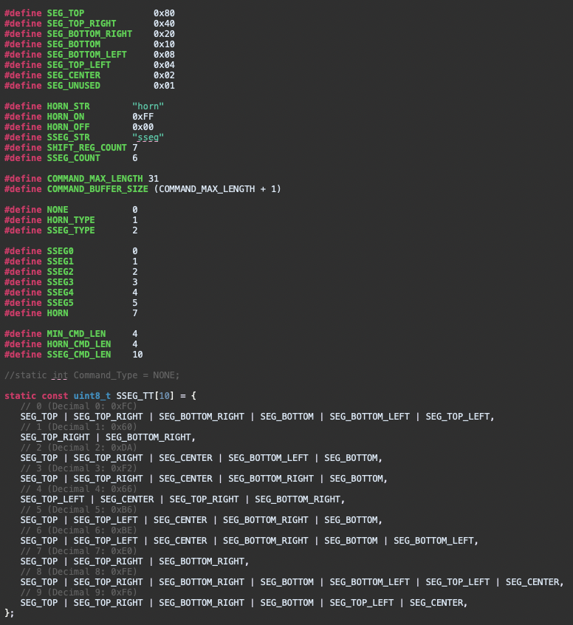
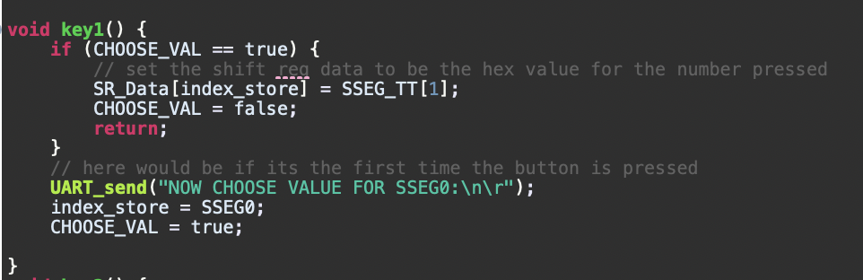
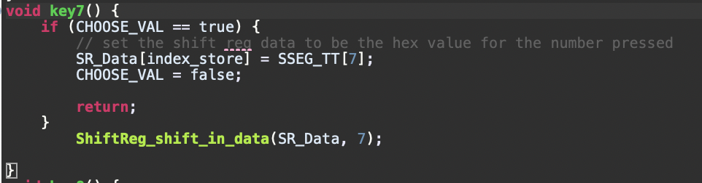
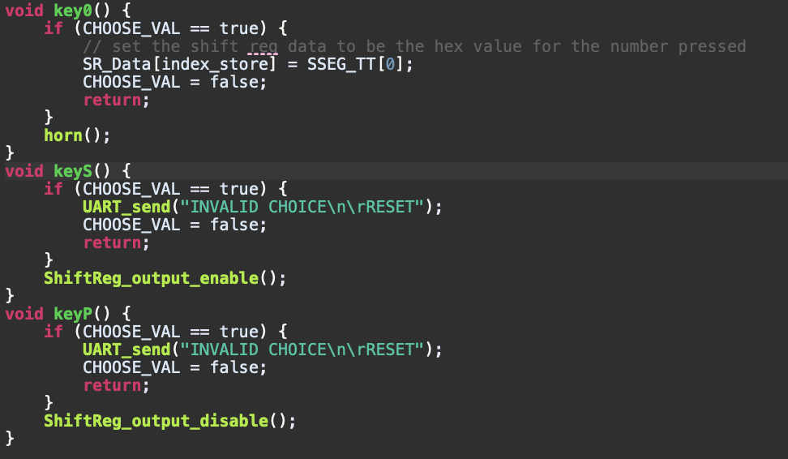
Application (SW) Design
Use keys to fill out the SR_Data array (global)
Press button 1-6 to choose which SSEG
Next, choose the number you want displayed
Now, next time you shift, that SSEG will display chosen number

Slide 20
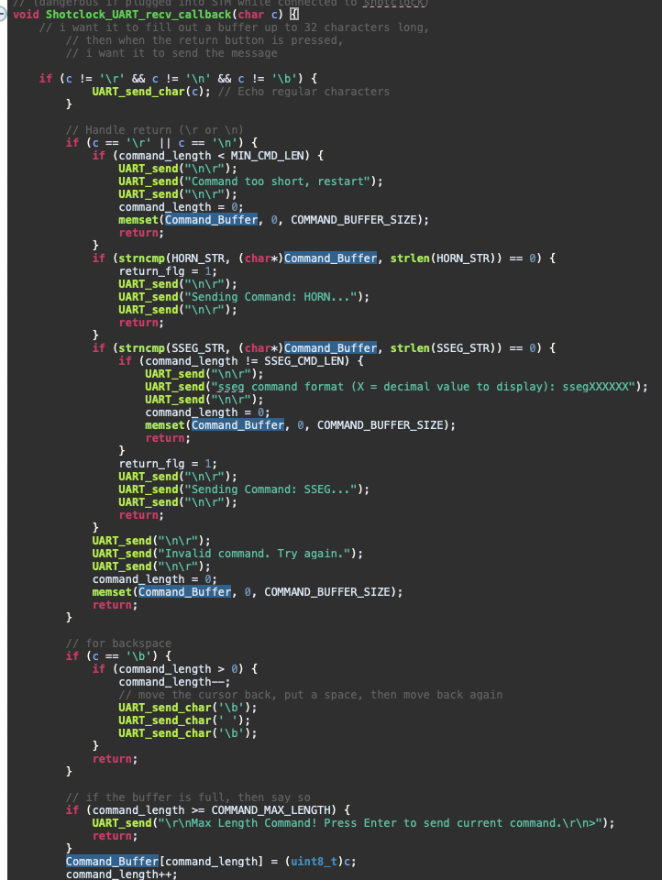
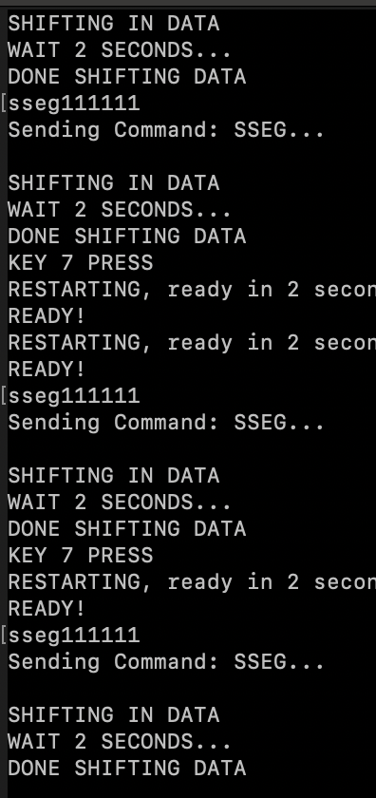
UART
Handles errors well

Slide 21
Collaboration
Collaborated on:
-Designing hardware
-Hardware issues
-Testing and debugging
-Acquiring components
-Shared code using Github
Alex:
- Designed software backend
- Integrated TPIC6595 interface to control shift registers
Radio software
Ben:
Desoldering
Wiring
Designed application using software infrastructure
Keypad / UART application

Slide 22
Lessons Learned
Careful with high voltages
Open drain implications
Ground loops risks
Opto-isolators
Relays

Slide 23
Future Possibilities
Integrate optocouplers
Replace fried radio transceiver
Remotely controlled clock
Original shotclock functionality

Slide 24

Q & A

